Slide 1
ANALYSIS OF HURRICANE TRACKS AND DEMOGRAPHICS TO ALLOCATE THE RELIEF RESOURCES
Presented by
Anuradha Tidke
Rehapriadarsini Manikandasamy
Venkata Gangadhar Naveen Palaka

Slide 2

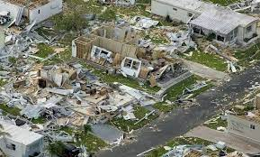

OUR PROBLEM
Hurricanes cause billions of dollars in damage annually in the United States
Projected to increase in intensity in the coming years
By exploring historical patterns of hurricanes and exposure of these hurricane-force winds across the landscape, areas of potentially high threat to future hurricane winds can be revealed[reference]
source
OUR GOAL
Track the path of some major hurricanes
Find commonly affected states
Find the health care center availability

Slide 3
OUR WORK
Useful variables
Hospital - 'COUNTYFIPS', 'BEDS'
Census - 'B01003_001E', 'B19001_001E’
County -'STATEFP’, 'COUNTYFP’, 'GEOID’, 'ALAND’, 'geometry'
New variables
Beds per County
Beds per 1000 people
Aland_sqmile
Population Density
Get the Data
Storm trajectory data
Hospital location data
Census data
Tigerfile countywise
Create &
Extract
Merge data
Track
Affected Counties
Plot – beds, income, population
Understand key distribution of variables
Plot the hurricane track with income
Income – Low, Middle, High
Plot the hurricane track
(with population density and beds per 1000)
Find
Categorize
Analysis involves Hurricane Ida (2021) and Laura (2020) – Two strongest hurricanes of their respective years

Slide 4

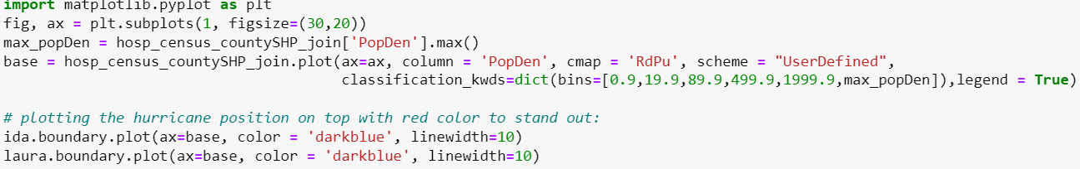
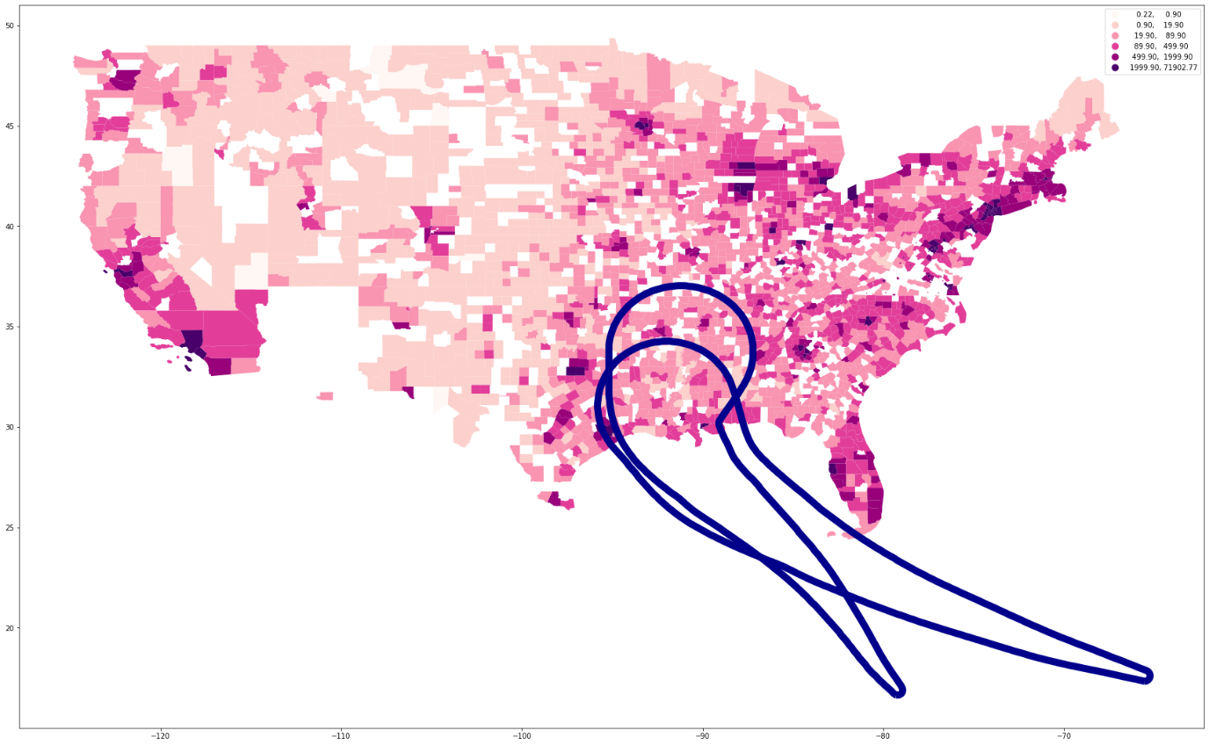
INTERESTING!!
Plotting "Population density" with hurricane tracks
The value limits to plot the following graph were taken from a similar visualization on:
https://www.census.gov/library/visualizations/2010/geo/population-density-county-2010.html

Slide 5
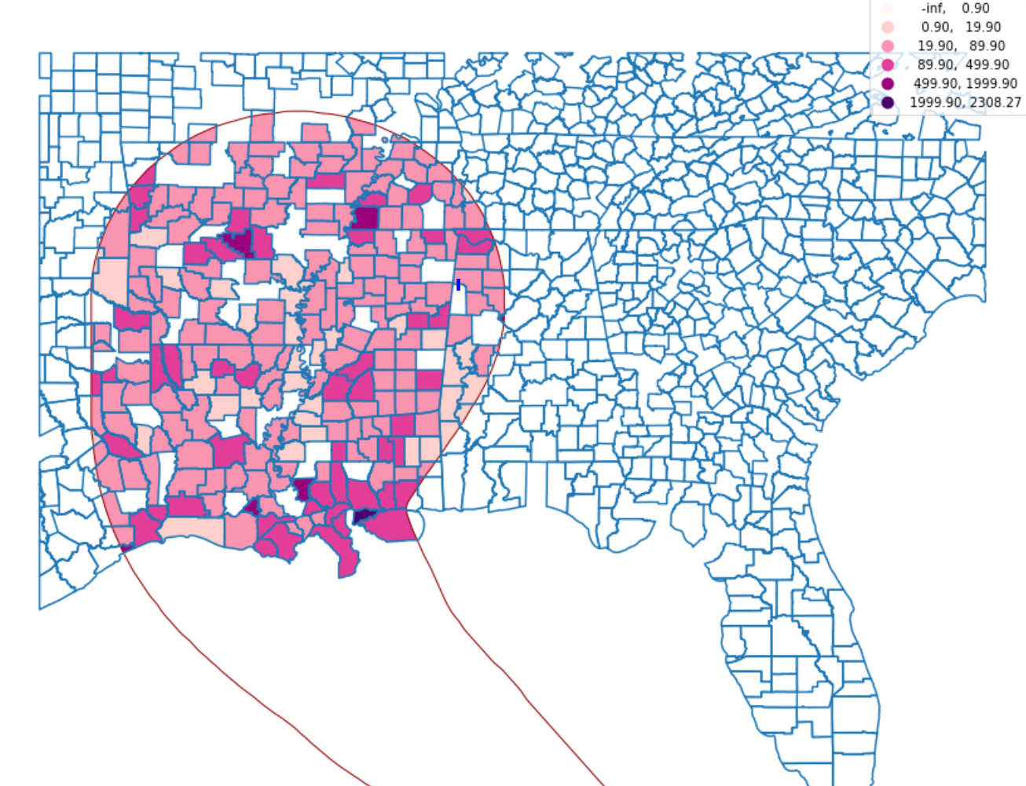
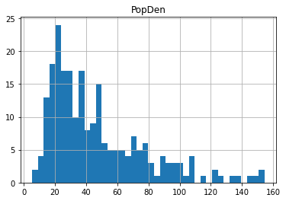
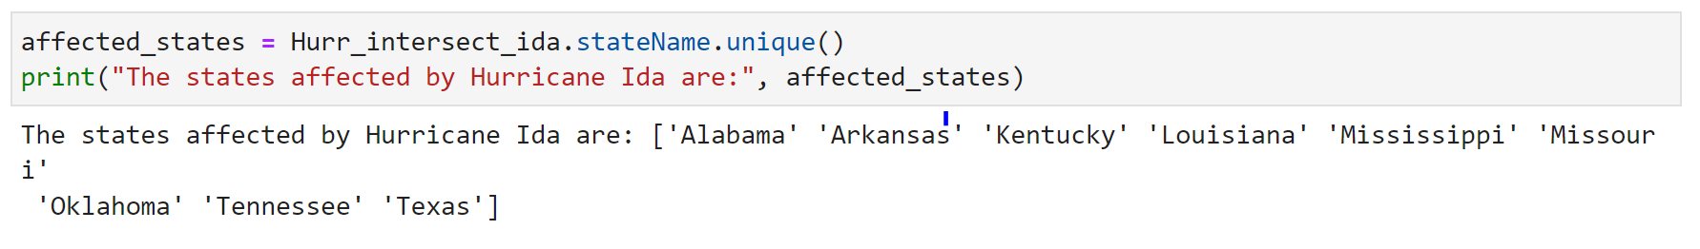
INTERESTING!!
From the histogram, we can see that the density of most of the counties is below 100.
Regions affected by hurricane:

Slide 6
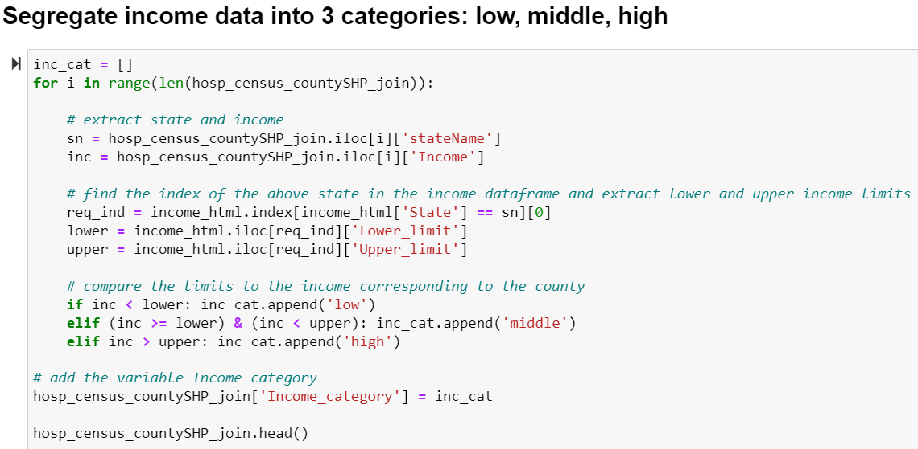
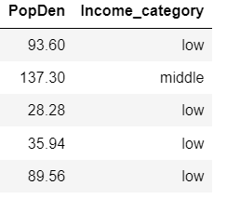
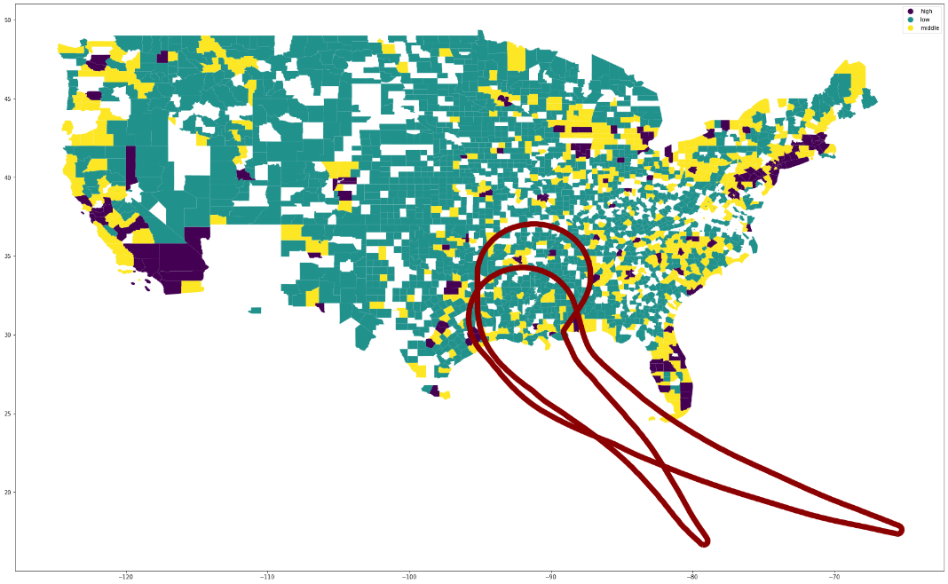
INTERESTING!!
Plotting "Income category" with hurricane tracks

Slide 7
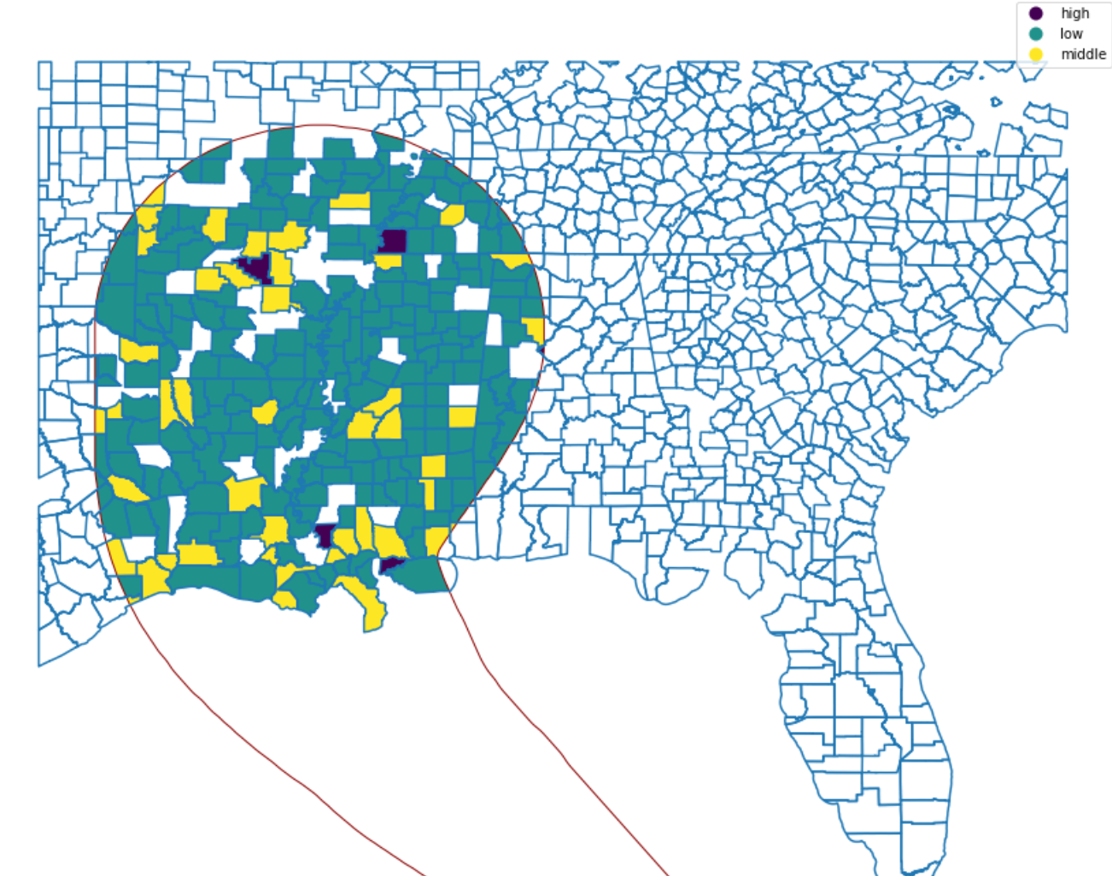
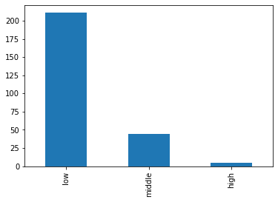
INTERESTING!!
We can see that most of the affected counties come under the low-income category. And from the map plotted above, we can know which are those counties and focus on appropriate relief efforts for them.

Slide 8
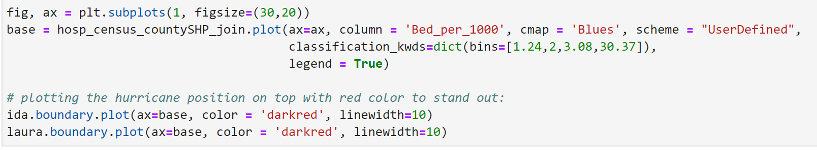
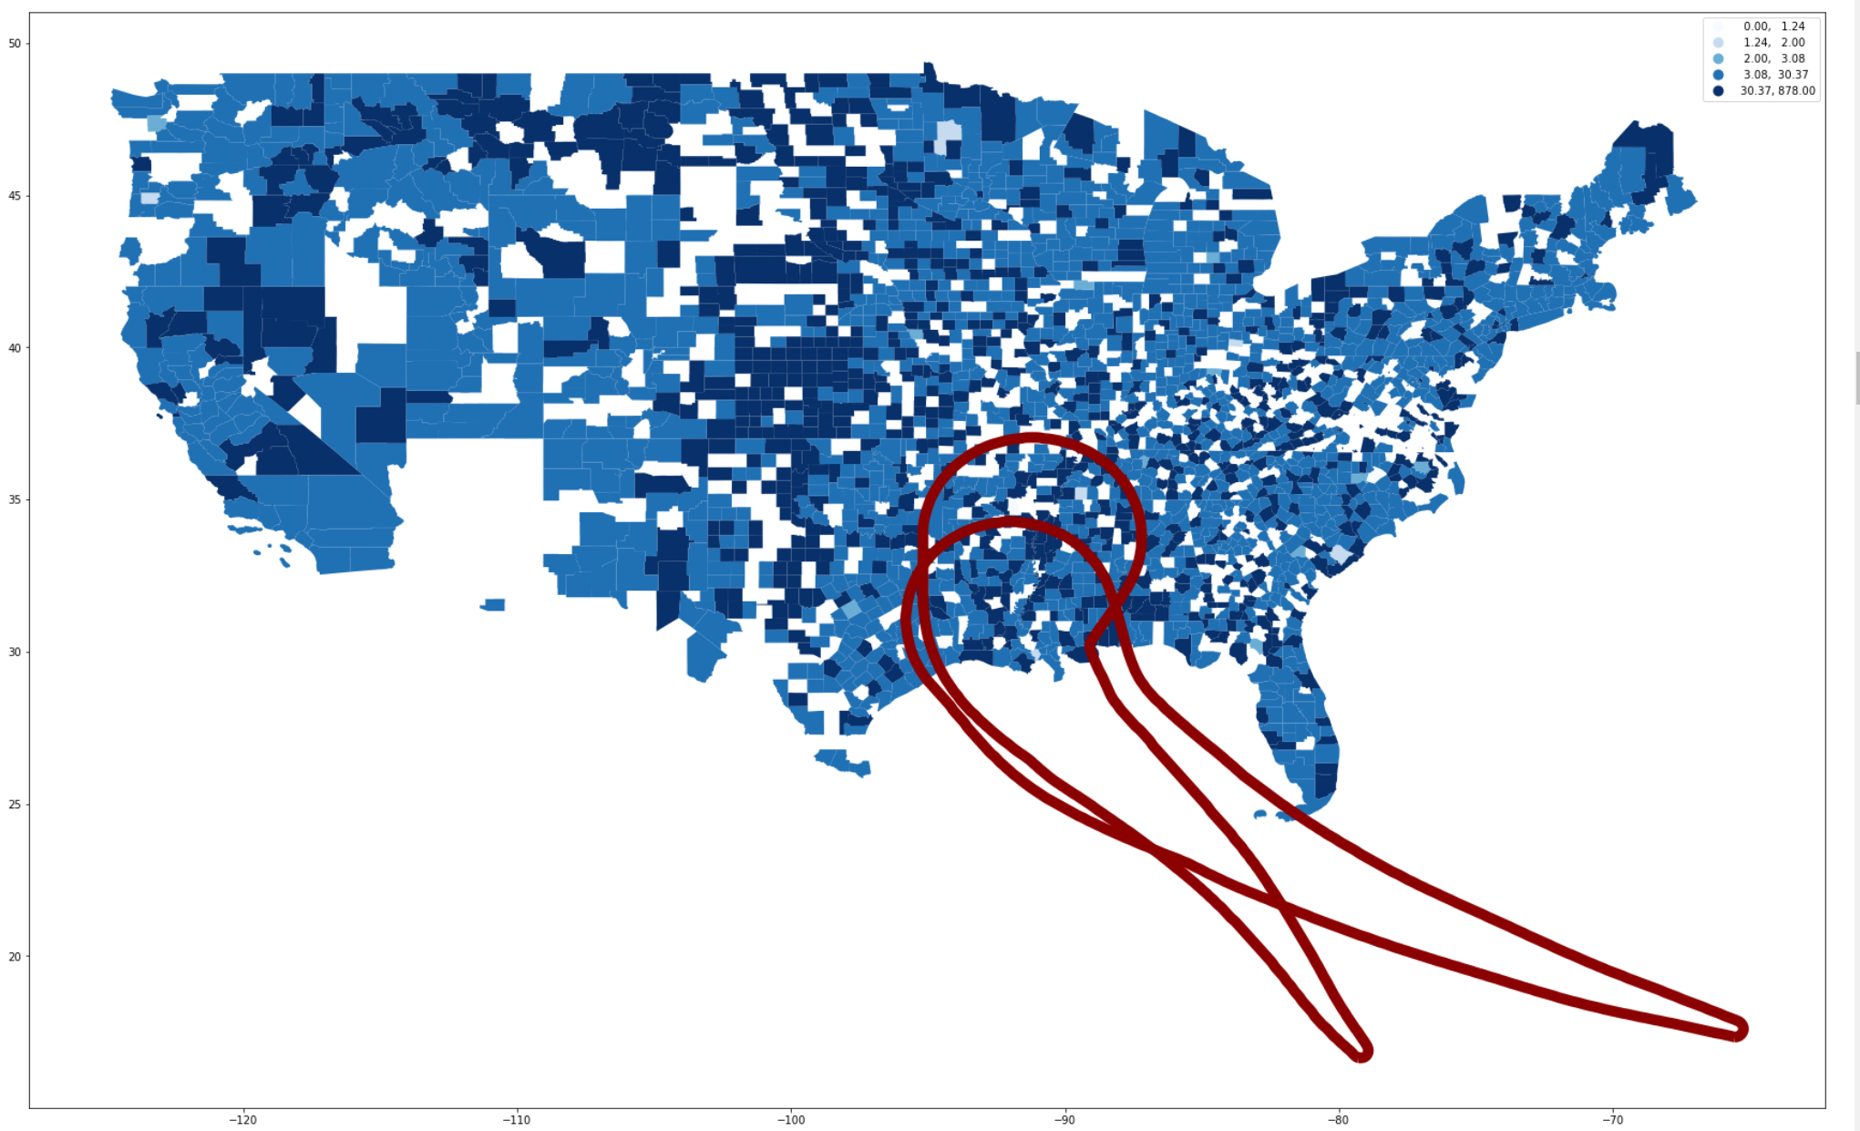
INTERESTING!!
Plotting "Bed per 1000" people with hurricane tracks
The value limits to plot the following graph were taken from a similar visualization on:
https://www.covidcaremap.org/maps/us-healthcare-system-capacity/#3.5/38/-96

Slide 9
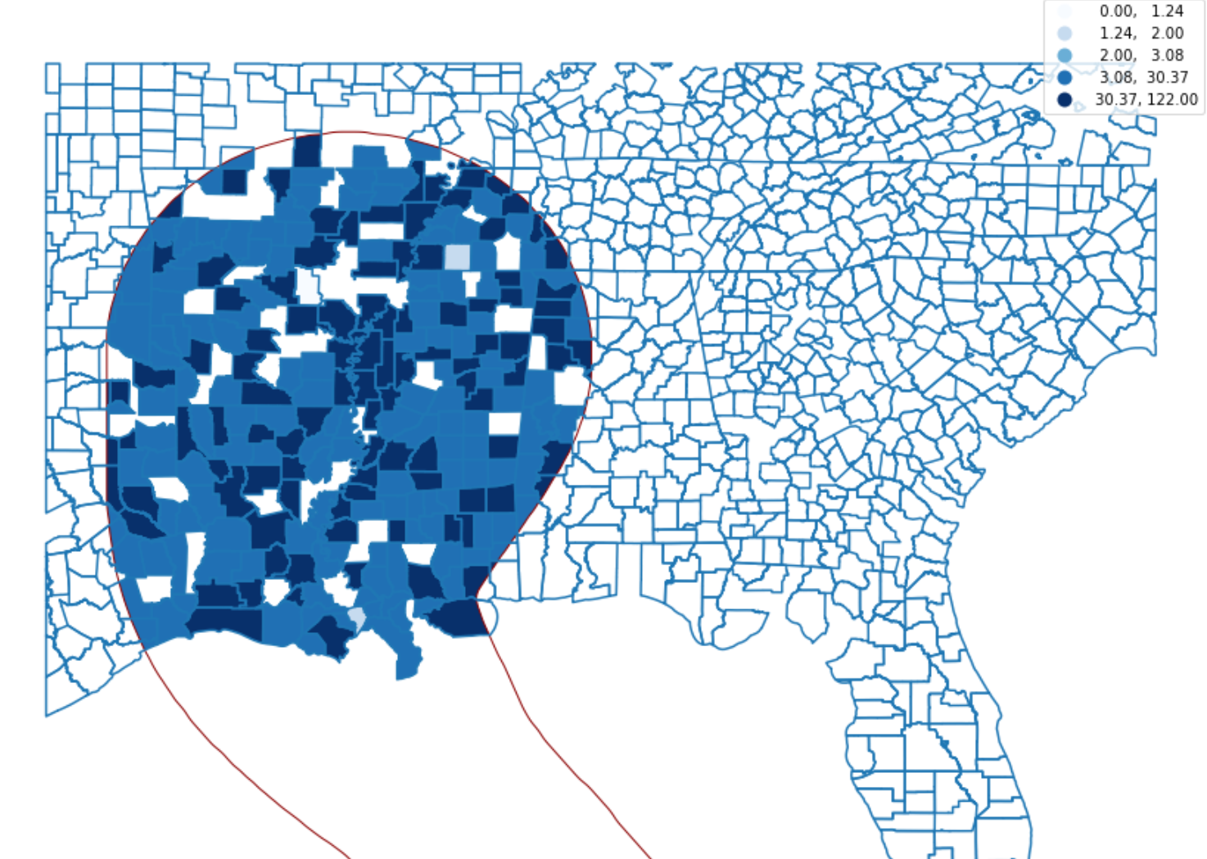
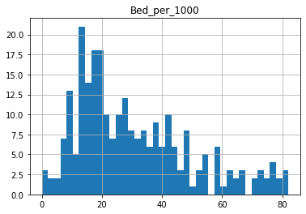
INTERESTING!!
From the above plot, we can find out which counties have the lowest bed availability per 1000 people and focus on medical relief efforts for those counties.

Slide 10

CONCLUSIONS
Most of the affected counties come under low-income category
Found which counties have the highest population density
Found which counties have the lowest bed availability per 1000 people and focus on medical relief efforts for those counties
Code reusability – Code has been designed in a way to replace the hurricane track data for any future hurricanes and analyze its impact on the US counties

